Slide 1

Research Methodology 4 (Semester One 2026)
LECTURE SIX
Reviewing the Literature
(Kumar Chapter 3)
09 March 2026
A LECTURE SERIES PRESENTED BY
DR E.FRANCKE

Slide 2
THE LITERATURE REVIEW
This lecture introduces you to the literature review as a practical skill in ICT research.
A good literature review helps you understand:
what is already known,
what methods have been used,
where the gaps are, and
how to justify your own study.

Slide 3
THE LITERATURE REVIEW
In Kumar’s research process, reviewing the literature:
supports problem formulation,
strengthens your research design choices, and
helps you write a credible proposal and final report (Kumar, 2011).

Slide 4
What is a literature review and why does it matter in ICT?
A literature review is a structured and critical reading of academic and professional sources relevant to your research problem.
It is not a list of summaries.
It builds an argument for why your study is needed and how it connects to existing knowledge.

Slide 5
What is a literature review and why does it matter in ICT?
ICT examples of what the literature helps you do:
• Avoid repeating work that has already been done (e.g., many usability studies already compare mobile menu designs).
• Choose a proven way of measuring your concept (e.g., using standard usability metrics such as task success rate, time-on-task, and error rate).
• Identify gaps and justify your study (e.g., plagiarism detection tools studied in general, but not in your campus context or for first-year ICT modules).
• Spot risks and limitations early (e.g., low response rates in student surveys, or bias when only interviewing ‘power users’).

Slide 6

Common source types (strongest to weakest for academic work):
Peer-reviewed journal articles (e.g., studies in HCI, cybersecurity behaviour, AI in education).
Conference papers (common in computing but still assess quality and publisher reputation).
Scholarly books and chapters (useful for concepts and established methods).
Industry and standards documents (e.g., ISO, NIST, OWASP) when relevant to your topic.
Credible technical blogs and vendor documentation (use carefully and triangulate with academic sources).
B. Sources you can use and how to judge quality

Slide 7
• Who wrote it and what are their credentials or institutional affiliation?
• Is it peer-reviewed or published by a recognised body?
• Is the evidence clear and the method explained?
• Is it recent enough for your topic (ICT changes quickly, but classics still matter for theory and methods)?
• Is it directly relevant to your research problem and objectives?
Quick quality check questions:

Slide 8
C. A practical search process for novice researchers.
Step 2: Use good search spaces
• Library databases and e-journals available through CPUT.
• Google Scholar for broad coverage (then verify journal quality).
• IEEE Xplore and ACM Digital Library for computing research.
• Scopus/Web of Science if available, to track citations and influential authors.

Slide 9
C. A practical search process for novice researchers.
Step 3: Apply inclusion and exclusion criteria
Decide what you will keep and what you will leave out before you start reading deeply.
• Inclusion examples: studies about higher education assessments; tools used for plagiarism detection; publications in the last 5 to 7 years.
• Exclusion examples: studies about primary school; articles with no method described; non-credible opinion pieces.
Step 4: Keep a search log
Record your keywords, databases, date searched, and the best results you found. This makes your review transparent and helps you avoid losing good sources.

Slide 10
Kumar emphasises that the literature review helps you refine your problem and understand what is already known. To do that well, you must read critically.
A simple critical reading template (use for each source):
Purpose: What question was the author trying to answer?
Context: Where and with whom was the study done?
Method: What design, sample, and instruments were used?
Findings: What did they discover (results, themes, patterns)?
Limitations: What could weaken the conclusions?
Relevance: What does this add to your own study?
D. Reading critically and extracting what you need

Slide 11
ICT example (reading for method):
If you are studying the user experience of a campus app, pay attention to how other studies measured usability (e.g.,
task scenarios,
sample sizes, and
the metrics reported).
This helps you design a stronger instrument later.
D. Reading critically and extracting what you need

Slide 12
E. From summary to synthesis.
A common beginner mistake is to write one paragraph per source. Instead, group sources by themes, variables, or methods, and then compare them.
Ways to organise your literature review:
• By themes (e.g., ‘trust in AI tools’, ‘false positives’, ‘student understanding of algorithms’).
• By methods (e.g., survey-based studies versus interview-based studies).
• By timeline (useful when technology or policy changes over time).
• By models or frameworks (e.g., Technology Acceptance Model in studies of tool adoption).

Slide 13
F. Writing the literature review in an academic style
Aim for a logical flow: introduce the topic area, define key concepts, compare what scholars have found, identify gaps, and end by linking the gap to your own research problem and objectives.
Practical writing tips:
• Use topic sentences that signal the theme of the paragraph.
• Compare sources in the same paragraph instead of listing them one by one.
• Use citations correctly and consistently (avoid copying wording from sources).
• End the section by stating the gap your study will address.

Slide 14
Broad ICT idea
AI is changing software development.
Researchable topic (one sentence, real context)
“How does the use of generative AI tools (such as GitHub Copilot or ChatGPT) influence code quality and developer productivity among software development students during project work?”
You can localise it even more by adding your institution name, a specific module, or a specific year group.
G. Example:
From Broad Idea to a Literature Review Plan

Slide 15
2) Keywords and synonyms (4 to 6)
We can start with these and expand as we search:
Generative AI (synonyms: GenAI, large language models, LLMs)
AI coding tools (synonyms: GitHub Copilot, ChatGPT, code assistant)
Software development (synonyms: programming, coding, software engineering)
Developer productivity (synonyms: efficiency, speed, time-to-complete, throughput)
Code quality (synonyms: maintainability, defects, bugs, code correctness)
Student developers (synonyms: novice programmers, ICT students, undergraduate developers).
G. Example:
From Broad Idea to a Literature Review Plan

Slide 16
3) Databases or search platforms (choose two)
Pick two that you can realistically access:
Google Scholar (broad coverage, good for starting)
IEEE Xplore (excellent for computing and software engineering research)
Optional alternatives: ACM Digital Library, ScienceDirect, CPUT library’s discovery portal.
G. Example:
From Broad Idea to a Literature Review Plan

Slide 17
4) Inclusion criteria (two)
Examples that make the search focused and fair:
Published between 2019 and 2026 (keeps it current for GenAI and coding tools).
Studies that examine AI coding tools in software development, and report outcomes related to productivity, code quality, learning, or developer behaviour.
G. Example:
From Broad Idea to a Literature Review Plan

Slide 18
5) Exclusion criteria (two)
Examples that prevent the review from drifting:
Exclude papers about AI for tasks unrelated to software development, e.g., AI in medicine, finance, or pure robotics (unless they directly study coding tools).
Exclude opinion pieces or blog posts without a research method, unless used only as background context (not as core evidence).
G. Example:
From Broad Idea to a Literature Review Plan

Slide 19
6) Record at least three relevant sources (title, author, year)
Source 1: Title: ____________________ | Author(s): ____________________ | Year: ______
Source 2: Title: ____________________ | Author(s): ____________________ | Year: ______
Source 3: Title: ____________________ | Author(s): ____________________ | Year: ______
G. Example:
From Broad Idea to a Literature Review Plan

Slide 20
I. What do you know at this stage?
For ICT students, the literature review is where you move from opinion to evidence.
It strengthens your research problem, improves your design decisions, and helps you write a proposal that is feasible and credible.
A strong review is systematic, critical, and clearly linked to your study’s aim and objectives.
Now, given that you will be doing SLR for your Projects 4 study, let’s take a look at SLR in more detail…

Slide 21
J. Conducting an SLR with PRISMA
Sometimes your research study will not collect new data.
Instead, you will systematically collect and analyse existing studies.
This is called a systematic literature review (SLR).
An SLR is more structured than a normal literature review because it follows a documented method for searching, screening, and selecting studies, so that your results are transparent and repeatable.

Slide 22
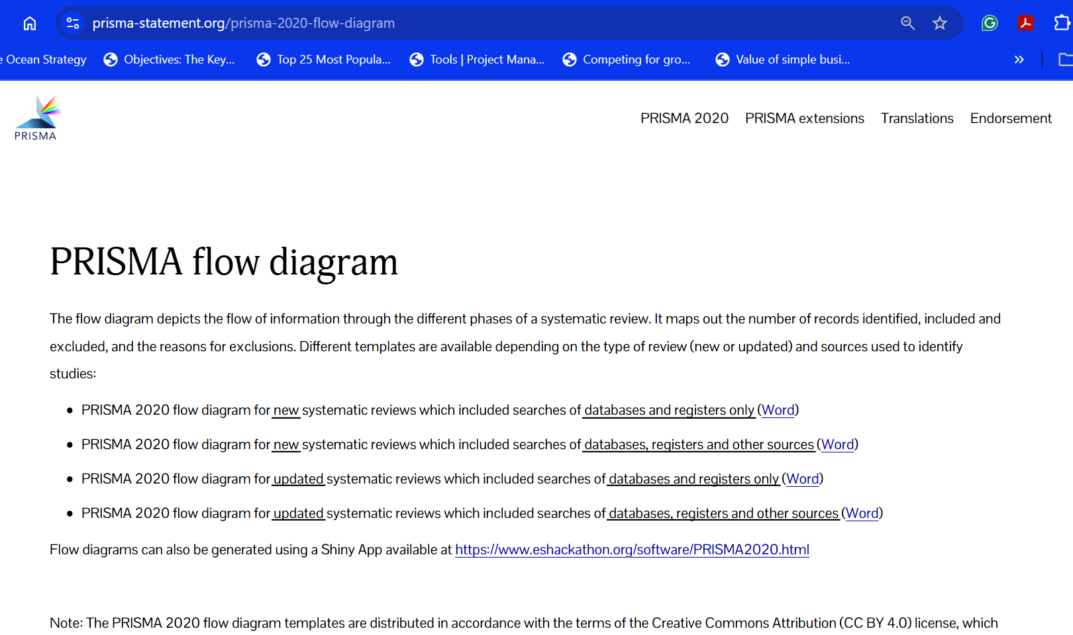

Slide 23
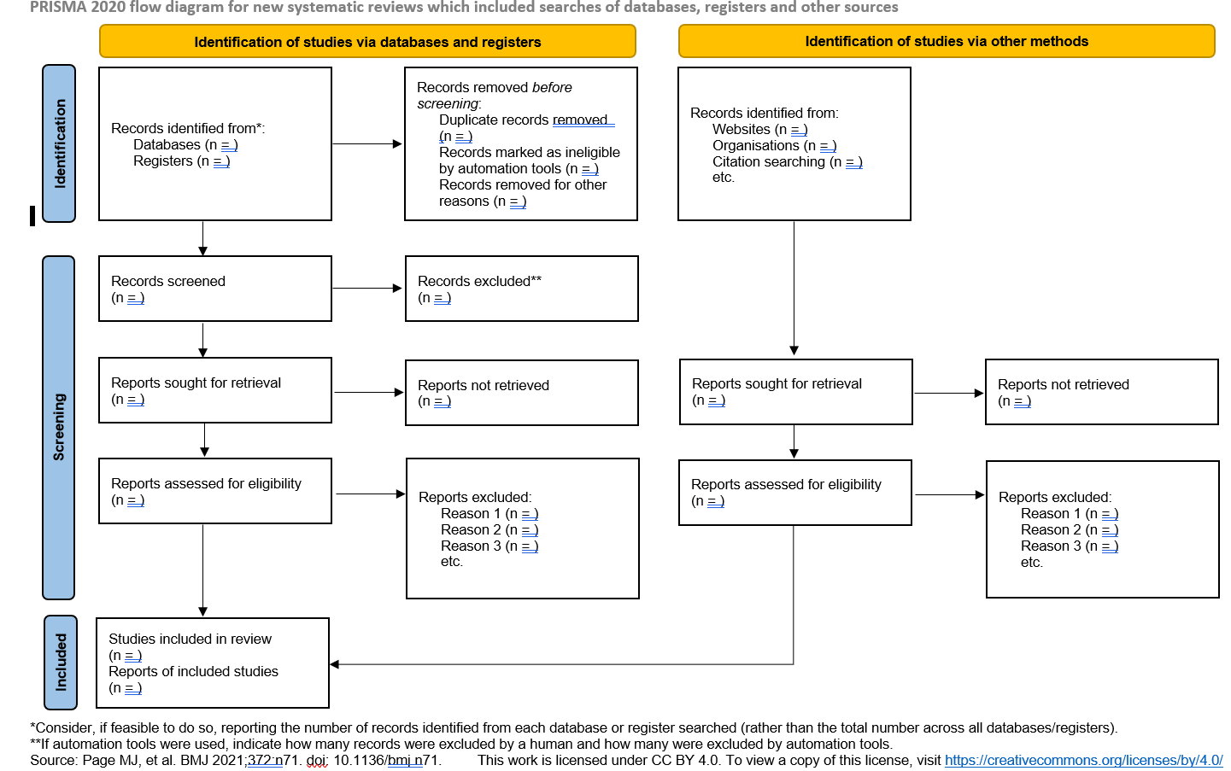

Slide 24
J. Conducting an SLR with PRISMA
PRISMA (Preferred Reporting Items for Systematic reviews and Meta-Analyses) is a guideline designed to improve how systematic reviews are reported.
It helps authors report why the review was done, what methods were used, and what results were found (PRISMA Statement, 2020).
Although PRISMA is a reporting guideline, it is also useful as a planning tool because it prompts you to document each step clearly (Page et al., 2021).
https://www.prisma-statement.org/

Slide 25
An SLR answers a focused research question by searching for all relevant studies using a planned, transparent method.
An SLR uses explicit inclusion and exclusion criteria and a documented screening process.
An SLR synthesises evidence (it does not simply summarise one source at a time).
An SLR is not a quick Google search, not a list of article summaries, and not a selection of only the sources you already agree with.
1. What an SLR is (and is not)

Slide 26
Step 1: Write a focused review question
• Use your Golden Thread: your question must align with your topic, problem, and aims.
• Example: What does current research say about the effect of cybersecurity awareness training on phishing susceptibility among university students?
Step 2: Define inclusion and exclusion criteria before you search
• Decide on: date range, population/context, type of evidence, language, and minimum quality expectations.
• Keep criteria simple and realistic for a first SLR (avoid overly complex filters).
2. A PRISMA-guided workflow you can follow

Slide 27
Step 3: Create your search plan (search strings + databases)
• Translate the question into 3 to 5 concepts and synonyms.
• Choose 2 to 3 databases you can access (e.g., Google Scholar plus IEEE Xplore/ACM Digital Library).
• Record the full search strings and the date searched (this becomes part of your PRISMA reporting).
2. A PRISMA-guided workflow you can follow

Slide 28
Step 4: Screen records in two stages
• Stage 1: Title and abstract screening using your criteria.
• Stage 2: Full-text screening for eligibility (document reasons for exclusion).
• Remove duplicates and keep counts at each stage.
Step 5: Extract key information from included studies
• Create a simple extraction table: author/year, context, method, sample, measures, and key findings.
• Extract only what helps answer your review question and objectives.
2. A PRISMA-guided workflow you can follow

Slide 29
Step 6: Appraise quality (basic and appropriate for your level)
• Use a simple checklist approach (e.g., method clarity, sample adequacy, limitations reported).
• Do not overcomplicate quality appraisal in your first SLR but do be transparent.
Step 7: Synthesis and write-up using PRISMA as a guide
• Group evidence by themes, methods, or outcomes.
• Report your search and screening process using the PRISMA flow diagram and checklist.
• Conclude by identifying what is known, what is uncertain, and what gaps remain.
2. A PRISMA-guided workflow you can follow

Slide 30
3. Using the PRISMA 2020 flow diagram (counts and transparency)
PRISMA recommends reporting the number of records identified, screened, assessed for eligibility, and included, and also reporting why full-text reports were excluded.
This is usually shown as a flow diagram. For this module, use the provided PRISMA 2020.
Identification: Where did you search and how many records did you find?
Screening: How many records remained after removing duplicates, and how many were excluded at title/abstract stage?
Eligibility: How many full texts were assessed, and what reasons were used to exclude reports?
Included: How many studies were finally included in your synthesis?

Slide 31
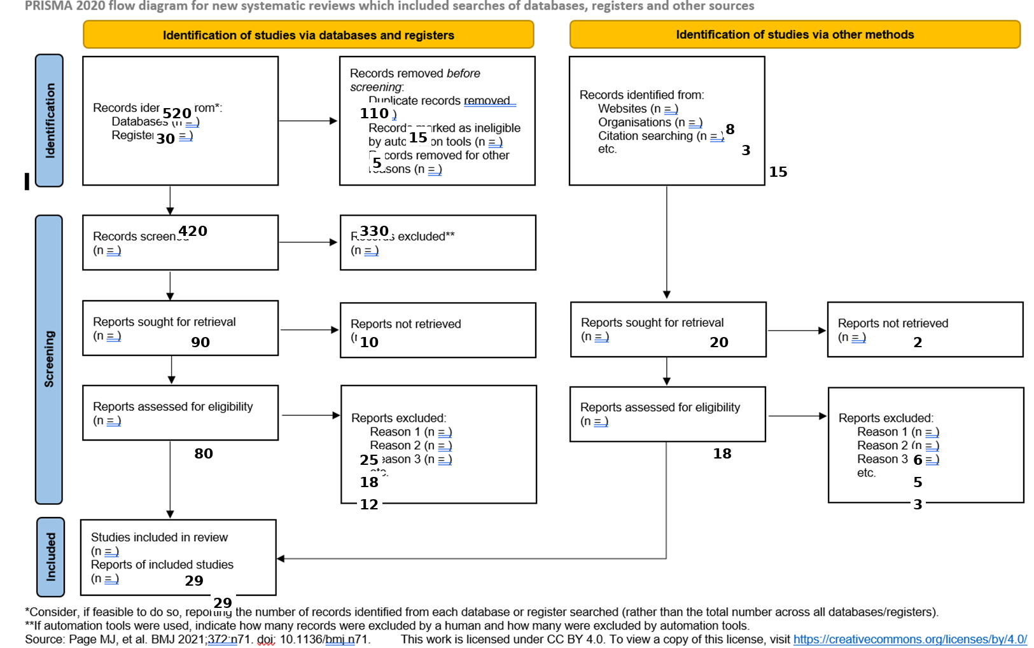

Slide 32
Identification
We start by searching for studies about cybersecurity awareness training and phishing susceptibility in university students. In this example, we identify 520 records from databases (like IEEE Xplore, ACM Digital Library, Scopus, and Google Scholar) and 30 records from registers, giving 550 total records found through databases and registers. The purpose of this stage is to show that your search was broad enough to capture the available research, not just a handful of convenient papers.
Records removed before screening
Before we start reading titles and abstracts, we clean the search results so we do not count the same study twice or keep items we cannot use. In this example, we remove 110 duplicates, meaning the same study appeared in more than one database. We also remove 15 records marked as ineligible by automation tools (for example, tools that flag records with missing metadata or non-research items) and 5 records removed for other reasons (for example, a broken record or clearly irrelevant item). After these removals, we have 420 records ready for screening.

Slide 33
Screening
Screening is where you apply your inclusion and exclusion criteria quickly by reading titles and abstracts. Your goal is to remove studies that are clearly not about your topic without wasting time downloading full texts. In this example, we screen 420 records and exclude 330 records because they do not match the focus (for example, they study employees instead of students, they discuss cybersecurity generally without phishing outcomes, or they are not training interventions). This leaves 90 reports sought for retrieval, meaning 90 items look potentially relevant and we try to obtain the full text.
Reports sought for retrieval
At this point, we attempt to access the full text of the studies that passed screening. This step matters because PRISMA requires transparency about what you could and could not retrieve. In this example, we seek 90 full-text reports, but 10 reports are not retrieved (for example, paywalled items you cannot access through your library, missing conference papers, or broken links). That leaves 80 full texts available to assess properly.

Slide 34
Eligibility
Eligibility is the deeper check where you read the full text and decide whether each study truly fits your review question and criteria. In this example, we assess 80 full-text reports for eligibility and exclude studies that fail the criteria at full-text level. We exclude 25 reports because they are not about university students, 18 reports because they do not measure a phishing outcome (for example, only attitudes toward cybersecurity), and 12 reports because they are not awareness training interventions (for example, they describe a security tool without evaluating training). After full-text exclusions, we keep the studies that genuinely address the question.
Identification via other methods
PRISMA also encourages you to show whether you searched beyond databases, as some relevant evidence may be found through other channels. In this example, we identify 8 records from websites, 3 from organisations, and 15 from citation searching, giving 26 records via other methods. Citation searching is especially useful when you find one strong paper and then check what it cites or who cited it, which can uncover key studies missed by database keywords.

Slide 35
Screening and eligibility for other methods
These additional records also go through retrieval and eligibility checks. In this example, we seek 20 reports for retrieval from other methods and 2 are not retrieved, leaving 18 full texts assessed for eligibility. We then exclude 6 because they are duplicates of database records, 5 because they are not empirical studies (for example, opinion pieces with no method), and 3 because they have the wrong outcome (for example, general security knowledge without phishing susceptibility measures). This stage shows that “other sources” are treated with the same discipline as database results.
Included
At the end of the process, PRISMA requires you to report what is actually included in your review. In this ICT example, the final set is 29 studies included in the review, and there are 29 reports of included studies. These are the studies you will extract data from and synthesise to answer your review question about how cybersecurity awareness training affects phishing susceptibility among university students. The key message for students is that inclusion is not about finding the biggest number, it is about finding the most relevant and defensible set of studies through a transparent process.

Slide 36
Higher Order Tutorial Question
In the literature review lecture, we learned that a strong review is not a random collection of summaries. It is a structured and critical reading process that helps you move from opinion to (1) ________. When you search, you should translate your topic into keywords and synonyms, then apply (2) ________ so you decide what to keep and what to leave out before you start reading deeply. If your study is a systematic literature review, you must go further by documenting each step transparently so another researcher can follow your process. PRISMA supports this transparency by guiding you to report the flow of records through identification, screening, eligibility, and inclusion, usually using a (3) ________. During screening, you remove irrelevant studies based on titles and abstracts, then confirm fit at full-text stage, keeping clear reasons for exclusion. After inclusion, you pull consistent information from each study into an extraction table, which is called (4) ________, and then you combine evidence by grouping findings into themes rather than writing one paragraph per article, which is known as (5) ________.
Answer Bank (6 options)
synthesis
evidence
inclusion and exclusion criteria
questions
PRISMA flow diagram
data extraction

Slide 37
Higher Order Tutorial Question
In the literature review lecture, we learned that a strong review is not a random collection of summaries. It is a structured and critical reading process that helps you move from opinion to evidence. When you search, you should translate your topic into keywords and synonyms, then apply inclusion and exclusion criteria so you decide what to keep and what to leave out before you start reading deeply. If your study is a systematic literature review, you must go further by documenting each step transparently so another researcher can follow your process. PRISMA supports this transparency by guiding you to report the flow of records through identification, screening, eligibility, and inclusion, usually using a PRISMA flow diagram. During screening, you remove irrelevant studies based on titles and abstracts, then confirm fit at full-text stage, keeping clear reasons for exclusion. After inclusion, you pull consistent information from each study into an extraction table, which is called data extraction, and then you combine evidence by grouping findings into themes rather than writing one paragraph per article, which is known as synthesis.
Answer Bank (6 options)
synthesis
evidence
inclusion and exclusion criteria
questions
PRISMA flow diagram
data extraction

Slide 38
THAT’S IT!!!
This chapter covered the Literature Review in general, but specifically covered the Systematic Literature Review, which you will use in your Projects 4 subject.

Slide 39
See you next week term!

